Slide 1
074
 | Bulk | Heavy | Medium | Light
Weight (g) | 240 | 235 | 3.15 | 1.75
Vol (mL) | 305 | 295 | 5.5 | 4.0
Bulk Density (g/mL) | 0.788 | 0.797 | 0.573 | 0.438
Proportion (%) | 100 | 98.0 | 1.31 | 0.73
AF (ppb) |  | 98.7, 72.3 | 3430 | 3280

Slide 2
036
 | Bulk | Heavy | Medium | Light
Weight (g) | 301 | 295 | 3.79 | 1.49
Vol (mL) | 390 | 375 | 6.5 | 6.0
Bulk Density (g/mL) | 0.771 | 0.787 | 0.583 | 0.248
Proportion (%) | 100 | 98.2 | 1.26 | 0.50
AF (ppb) |  | 0, 0 | 3750 | 3510

Slide 3
024
 | Bulk | Heavy | Medium | Light
Weight (g) | 286 | 273 | 10.0 | 2.33
Vol (mL) | 375 | 351 | 15.8 | 5.9
Bulk Density (g/mL) | 0.763 | 0.778 | 0.633 | 0.395
Proportion (%) | 100 | 95.7 | 3.50 | 0.82
AF (ppb) |  | 86.7, 150 | 4230 | 4090

Slide 4
073
 | Bulk | Heavy | Medium | Light
Weight (g) | 295 | 283 | 9.11 | 2.55
Vol (mL) | 385 | 366 | 15.0 | 5.8
Bulk Density (g/mL) | 0.767 | 0.773 | 0.607 | 0.440
Proportion (%) | 100 | 96.0 | 3.09 | 0.87
AF (ppb) |  | 97.3, 158 | 248 | 3690

Slide 5
060
 | Bulk | Heavy | Medium | Light
Weight (g) | 299 | 292 | 4.42 | 2.86
Vol (mL) | 385 | 370 | 9.0 | 6.0
Bulk Density (g/mL) | 0.775 | 0.786 | 0.491 | 0.477
Proportion (%) | 100 | 97.6 | 1.48 | 0.96
AF (ppb) |  | 3910, 4230 | 3500 | 3950

Slide 6
090
 | Bulk | Heavy | Medium | Light
Weight (g) | 260 | 256 | 3.13 | 0.853
Vol (mL) | 320 | 315 | 5.5 | 3.0
Bulk Density (g/mL) | 0.812 | 0.813 | 0.569 | 0.284
Proportion (%) | 100 | 98.5 | 1.20 | 0.33
AF (ppb) |  | 0, 0 | 1560 | 3630

Slide 7
RxR non-inoc
 | Bulk | Heavy | Medium | Light
Weight (g) | 301 | 287 | 12.4 | 2.33
Vol (mL) | 370 | 350 | 18.0 | 3.6
Bulk Density (g/mL) | 0.814 | 0.820 | 0.689 | 0.647
Proportion (%) | 100 | 95.1 | 4.11 | 0.77
AF (ppb) |  | 21.0, 0.695 | 3440 | 2560

Slide 8
RxR inoc
 | Bulk | Heavy | Medium | Light
Weight (g) | 302 | 291 | 10.2 | 1.12
Vol (mL) | 370 | 352 | 14.8 | 1.7
Bulk Density (g/mL) | 0.817 | 0.827 | 0.689 | 0.659
Proportion (%) | 100 | 96.3 | 3.37 | 0.37
AF (ppb) |  | 242, 193 | 305 | 120

Slide 9
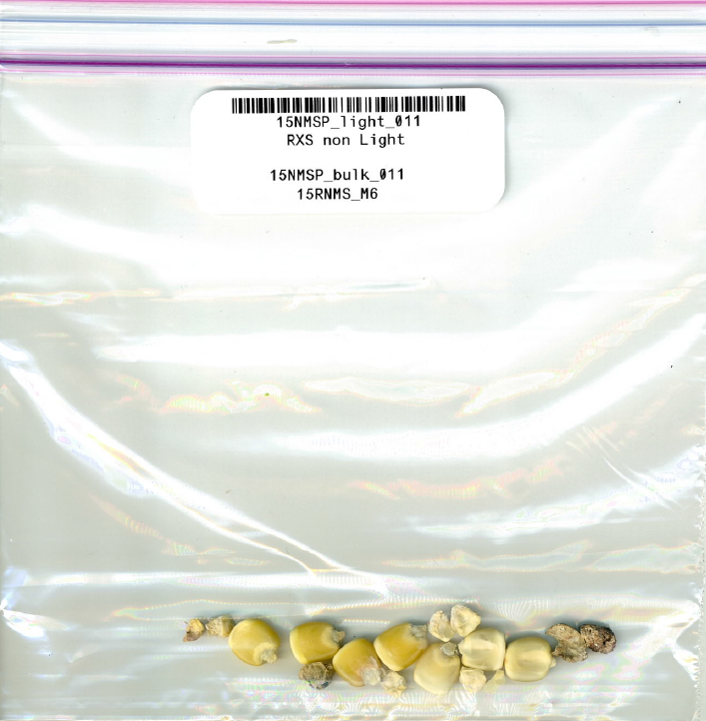
RxS non-inoc
 | Bulk | Heavy | Medium | Light
Weight (g) | 309 | 296 | 9.32 | 3.21
Vol (mL) | 395 | 377 | 14.8 | 5.6
Bulk Density (g/mL) | 0.783 | 0.785 | 0.630 | 0.573
Proportion (%) | 100 | 95.9 | 3.02 | 1.04
AF (ppb) |  | 69.4, 0 | 3730 | 3370

Slide 10
RxS inoc
 | Bulk | Heavy | Medium | Light
Weight (g) | 306 | 295 | 9.68 | 1.37
Vol (mL) | 395 | 380 | 15.0 | 2.5
Bulk Density (g/mL) | 0.775 | 0.776 | 0.645 | 0.548
Proportion (%) | 100 | 96.4 | 3.16 | 0.45
AF (ppb) |  | 137, 127 | 20.8 | 130

Slide 11
SxS non-inoc
 | Bulk | Heavy | Medium | Light
Weight (g) | 299 | 281 | 16.1 | 1.52
Vol (mL) | 390 | 360 | 24.4 | 4.0
Bulk Density (g/mL) | 0.766 | 0.781 | 0.660 | 0.380
Proportion (%) | 100 | 94.1 | 5.39 | 0.51
AF (ppb) |  | 38.0, 44.4 | 44.4 | 383

Slide 12
SxS inoc
 | Bulk | Heavy | Medium | Light
Weight (g) | 301 | 288 | 11.1 | 1.70
Vol (mL) | 390 | 370 | 17.5 | 2.5
Bulk Density (g/mL) | 0.772 | 0.778 | 0.634 | 0.680
Proportion (%) | 100 | 95.7 | 3.69 | 0.57
AF (ppb) |  | 33.4, 58.0 | 3700 | 3520

Slide 16
Bulk Density may not be the only factor determining AF levels.
Kernel shape and size may also play a part.

